Slide 1
Recent Developments in Deep Learning
Quoc V. Le
Stanford University and Google
Notes:
I will talk about our recent work on scaling up machine learning, and specifically a class of algorithms called deep learning. This talk is mainly about techniques to scale up these algorithms using ten thousands of machines… and their success stories, and exciting results thanks to scaling up. Before I continue,
----- Meeting Notes (2/25/13 18:06) -----
capit

Slide 2
Purely supervised
Quoc V. Le

Slide 3
Deep Learning
Almost abandoned between 2000-2006
- Overfitting, slow, many local minima, gradient vanishing
In 2006, Hinton, et. al. proposed RBMs to pretrain a deep neural network
In 2009, Raina, et. al. proposed to use GPUs to train deep neural network
Quoc V. Le
Notes:
So far,

Slide 4
Deep Learning
In 2010, Dahl, et. al. trained a deep neural network using GPUs to beat the state-of-the-art in speech recognition
In 2012, Le, et. al. trained a deep neural network using a cluster of machines to beat the state-of-the-art in ImageNet
In 2012, Krizhevsky, et. al. won the ImageNet challenge with NN
In 2012, Mikolov, et. al. trained a recurrent neural network to achieve state-of-the-art in language modelling
Quoc V. Le
Notes:
So far,

Slide 5
State-of-the-art in Acoustic Modelling
Language modelling
HMM
Acoustic modelling
Acoustic modelling:
Previous method: Mixture of Gaussians
M.D. Zeiler, M. Ranzato, R. Monga, M. Mao, K. Yang, Q.V. Le, P. Nguyen, A. Senior, V. Vanhoucke, J. Dean, G. Hinton. On Rectified Linear Units for Speech Processing. ICASSP, 2013.
Quoc V. Le
Notes:
So far,

Slide 6
Purely supervised
Classifying phonemes
Quoc V. Le

Slide 7
State-of-the-art in Computer Vision
Previous method: Hand-crafted features
Q.V. Le, M.A. Ranzato, R. Monga, M. Devin, K. Chen, G.S. Corrado, J. Dean, A.Y. Ng. Building high-level features using large scale unsupervised learning. ICML, 2012
Krizhevsky, A., Sutskever, I. and Hinton, G. E. ImageNet Classification Using Deep Convolutional Neural Networks. NIPS 2012
Quoc V. Le

Slide 8
State-of-the-art in Computer Vision
Architecture:
Trained using unsupervised data, layer by layer
Quoc V. Le

Slide 9
Deep Learning at Google
What Google have?
Lots of data
Lots of computations
Problems that require good features
What Google don’t have?
Time to invent features for each of the problems
Quoc V. Le

Slide 10
Local receptive field networks
Machine #1
Machine #2
Machine #3
Machine #4
RICA features
Image
Le, et al., Tiled Convolutional Neural Networks. NIPS 2010

Slide 11
Asynchronous Parallel Stochastic Gradient Descent
Parameter Server
W’ = W + α ∆W
∆W
W’
Model
Workers
Data
Shards
Le, et al., Building high-level features using large-scale unsupervised learning. ICML 2012
Dean, et al., Large scale distributed deep networks. NIPS 2012.

Slide 12
Sparse Autoencoders
(RICA - Le, et al, 2011)
λ
x: Input data
m: Number of examples
: Trade of between reconstruction and sparsity
W: Parameter matrix
Number of rows in W: The number of features
Feature representation:
Le, et al., ICA with Reconstruction Cost for Efficient Overcomplete Feature Learning. NIPS 2011

Slide 13
Training
RICA
Dataset: 10 million 200x200 unlabeled images from YouTube/Web
Train on 2000 machines (16000 cores) for 1 week using Google
infrastructure
1.15 billion parameters
100x larger than previously reported
Small compared to visual cortex
RICA
RICA
Image
Le, et al., Building high-level features using large-scale unsupervised learning. ICML 2012
Input to another layer above
(image with 8 channels)
Number of output
channels = 8
LCN Size = 5
H
Pooling Size = 5
Number
of maps = 8
One layer
W
RF size = 18
Number of input
channels = 3
Image Size = 200

Slide 14
Visualization
a₁
a₂
a₃
x₁
x₂
x₃
x₄
Notes:
Sparse coding is also used to create a feature hierarchy by using the idea of stacking. Informally, it means that after learning the first layer of features for sparse coding, we add another layer on top to create another set of features. In practice, this means it creates a hierarchy of features where the layers are increasingly more high-level.

Slide 15
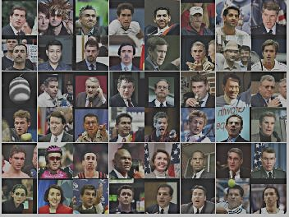
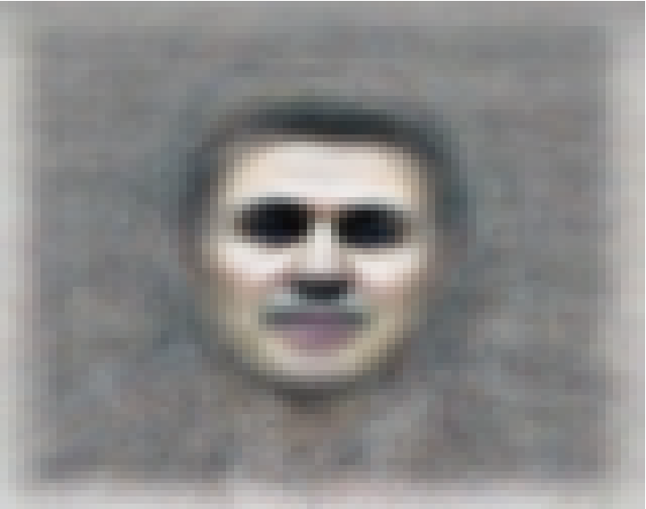
The face neuron
Top stimuli from the test set
Optimal stimulus
by numerical optimization
Le, et al., Building high-level features using large-scale unsupervised learning. ICML 2012

Slide 16
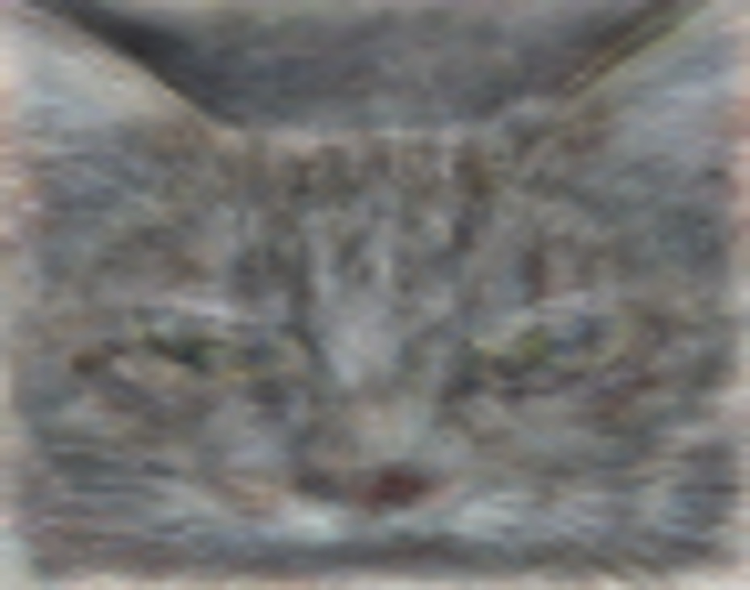
The cat neuron
Optimal stimulus
by numerical optimization
Le, et al., Building high-level features using large-scale unsupervised learning. ICML 2012
Notes:
Funny new york times article

Slide 17
Feature Visualization
Feature 1
Feature 2
Feature 3
Feature 4
Le, et al., Building high-level features using large-scale unsupervised learning. ICML 2012
Input to another layer above
(image with 8 channels)
Number of output
channels = 8
LCN Size = 5
H
Pooling Size = 5
Number
of maps = 8
One layer
W
RF size = 18
Number of input
channels = 3
Image Size = 200

Slide 18
Feature Visualization
Feature 5
Feature 6
Feature 7
Feature 8
Le, et al., Building high-level features using large-scale unsupervised learning. ICML 2012
Input to another layer above
(image with 8 channels)
Number of output
channels = 8
LCN Size = 5
H
Pooling Size = 5
Number
of maps = 8
One layer
W
RF size = 18
Number of input
channels = 3
Image Size = 200

Slide 19
ImageNet classification
22,000 categories
14,000,000 images
Hand-engineered features (SIFT, HOG, LBP),
Spatial pyramid, SparseCoding/Compression
Le, et al., Building high-level features using large-scale unsupervised learning. ICML 2012

Slide 20
Input to a 22,000-way classifier
a₁
a₂
a₃
x₁
x₂
x₃
x₄

Slide 21
0.005%
9.5%
18.3%
Random guess
State-of-the-art
(Weston, Bengio ‘11)
Feature learning
From raw pixels
Using only 1000 categories, our method > 60%
Le, et al., Building high-level features using large-scale unsupervised learning. ICML 2012

Slide 22
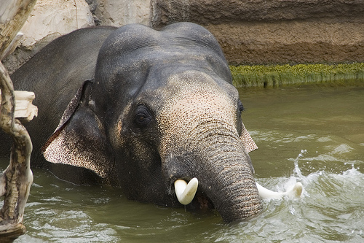
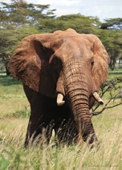
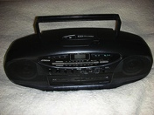
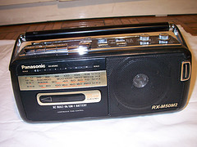
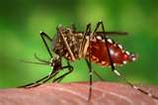
Indian elephant
African elephant
Cassette player
Tape player
Malaria mosquito
Yellow fever mosquito

Slide 23
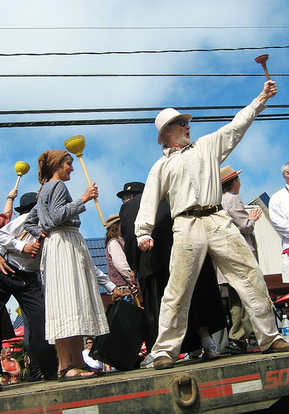
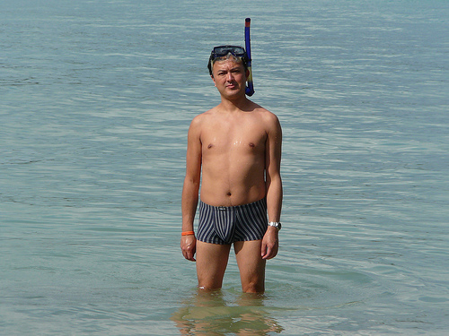
People / Plunger
Swimming / Person / Swim trunk / Snorkel
People / Tree / Street / Marching order /…
Bearskin
Person / People / Pingpong / Wheel / …
/ Ping-pong ball

Slide 24
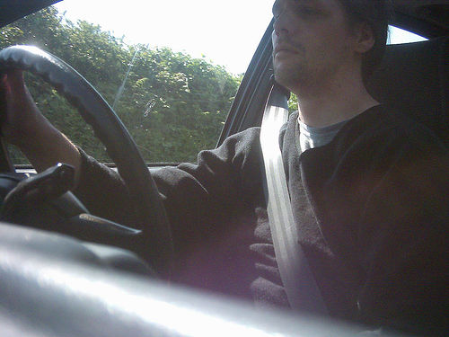
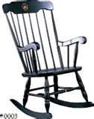
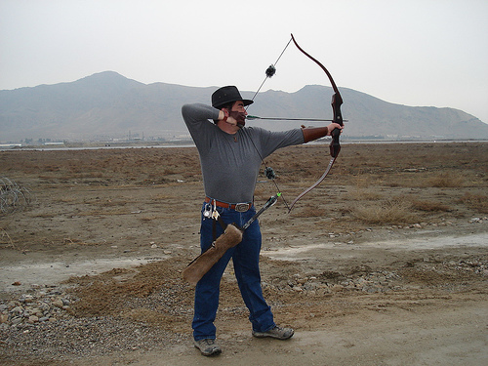
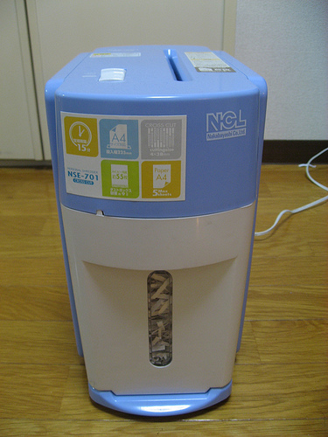
Seat-belt
Boston rocker
Archery
Shredder
Quoc V. Le

Slide 25
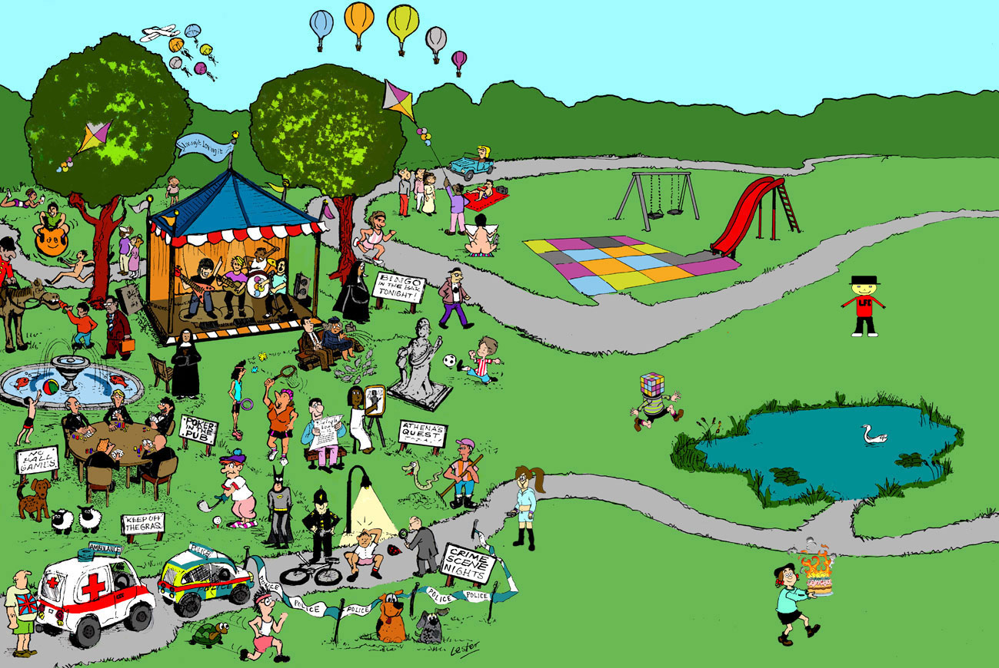
Face
Amusement, Park
Hammock
Quoc V. Le

Slide 26
Dean, et al., Large scale distributed deep networks. NIPS 2012.

Slide 27
Theoretical questions
Properties of local minima and generalization
Role of unsupervised pretraining
Better weight initialization
Nonlinearities and invariance properties
Quoc V. Le

Slide 28
References
Q.V. Le, M.A. Ranzato, R. Monga, M. Devin, G. Corrado, K. Chen, J. Dean, A.Y. Ng. Building high-level features using large-scale unsupervised learning. ICML, 2012.
Q.V. Le, J. Ngiam, Z. Chen, D. Chia, P. Koh, A.Y. Ng. Tiled Convolutional Neural Networks. NIPS, 2010.
Q.V. Le, W.Y. Zou, S.Y. Yeung, A.Y. Ng. Learning hierarchical spatio-temporal features for action recognition with independent subspace analysis. CVPR, 2011.
Q.V. Le, T. Sarlos, A. Smola. Fastfood – Approximate nonlinear expansions in loglinear time. ICML, 2013
Q.V. Le, J. Ngiam, A. Coates, A. Lahiri, B. Prochnow, A.Y. Ng. On optimization methods for deep learning. ICML, 2011.
Q.V. Le, A. Karpenko, J. Ngiam, A.Y. Ng. ICA with Reconstruction Cost for Efficient Overcomplete Feature Learning. NIPS, 2011.
Q.V. Le, J. Han, J. Gray, P. Spellman, A. Borowsky, B. Parvin. Learning Invariant Features for Tumor Signatures. ISBI, 2012.
I.J. Goodfellow, Q.V. Le, A.M. Saxe, H. Lee, A.Y. Ng, Measuring invariances in deep networks. NIPS, 2009.
http://ai.stanford.edu/~quocle

